Slide 1
Understanding Version Control System
Muhammad Asaduzzaman
School of Computer Science
University of Windsor
Used content from the Pro Git book
https://git-scm.com/book/en/v2

Slide 2
What is a Version Control System
A version control system records changes to a file or set of files so that we can retrieve the content of a file at a specific point in time.

Slide 3
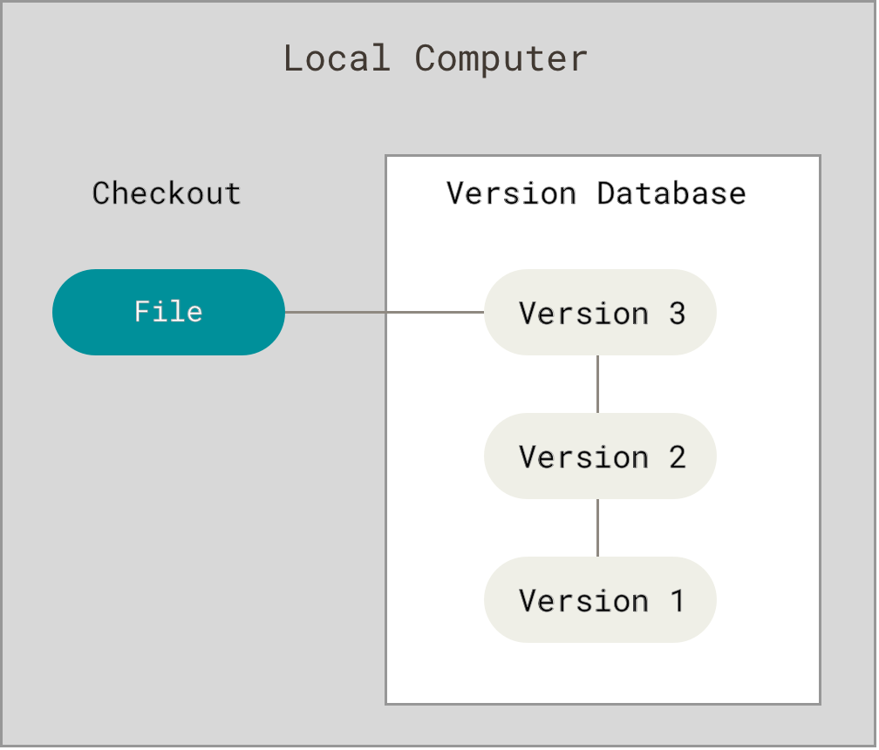
Local Version Control System
When you make changes to a file, you can accidentally change the content of the file that you don’t want to, accidentally write to the wrong file, delete the file or copy over files that you don’t mean to.

Slide 4
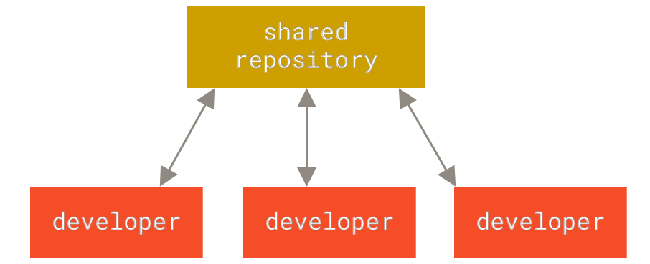
Centralized Version Control System
In a centralized version control system, there is a single repository (or server) that contains all the versioned files.

Slide 5
What are the benefits and drawback?

Slide 6
Benefits of Centralized Version Control System
Everyone knows about the latest state of the repository
This enables collaboration among multiple developers that can check out files from the central repository
Administrators have fine control over who can do what

Slide 7
Drawback of Centralized Version Control System
Single point of failure

Slide 8
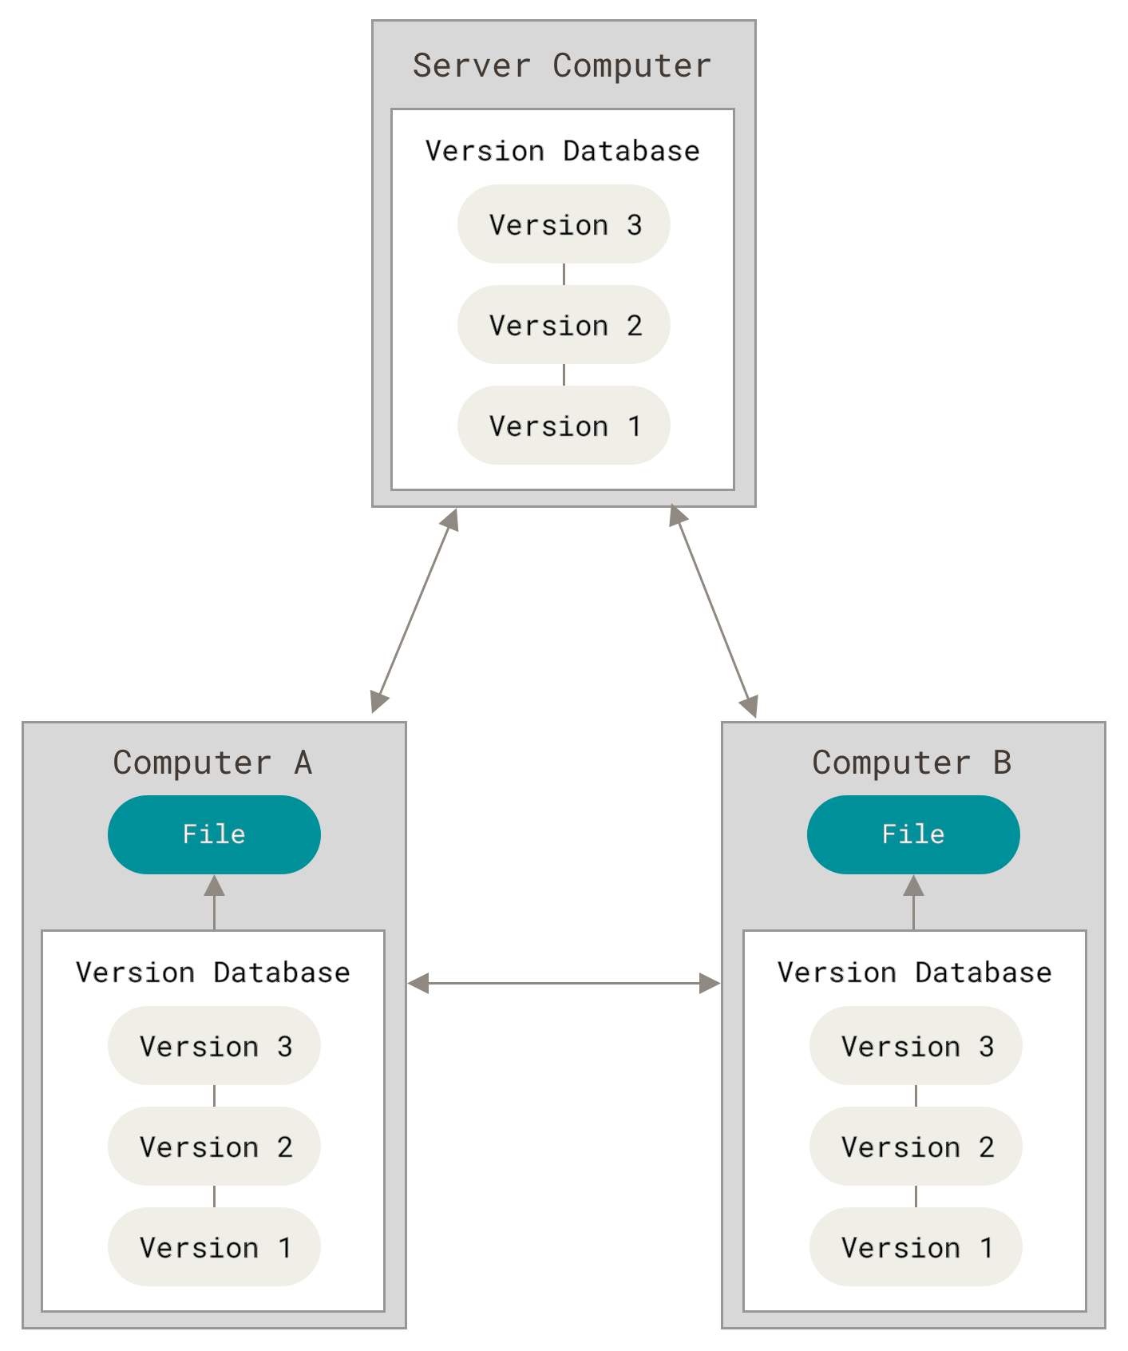
Distributed Version Control System
Every client has a complete copy of the repository (i.e., full history)
If the server dies, the content can be copies back to the server from a client

Slide 9
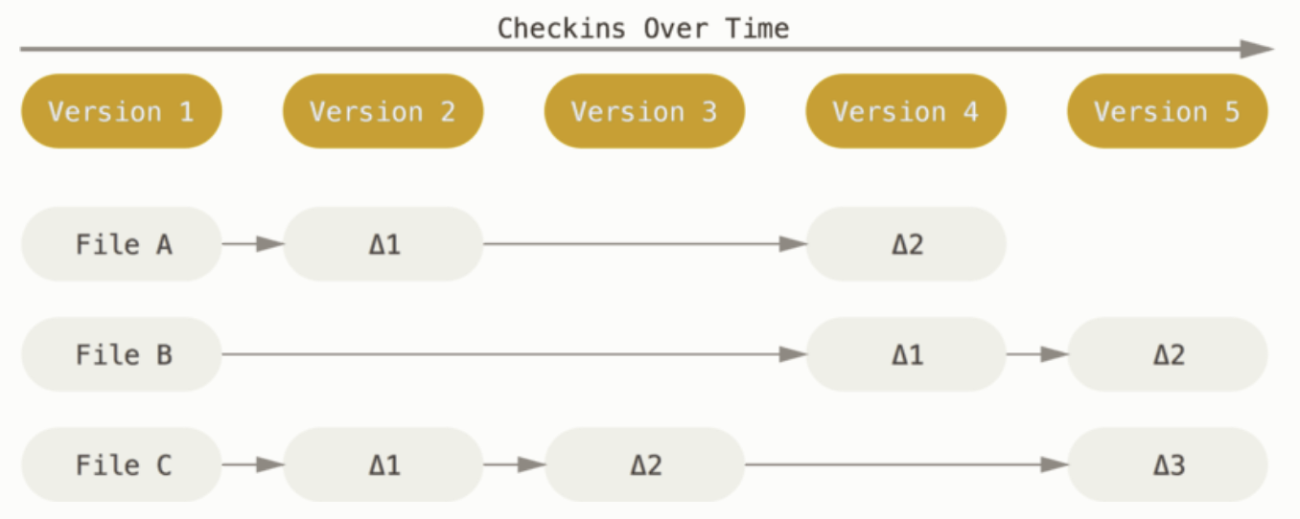
Delta-based version control system

Slide 10
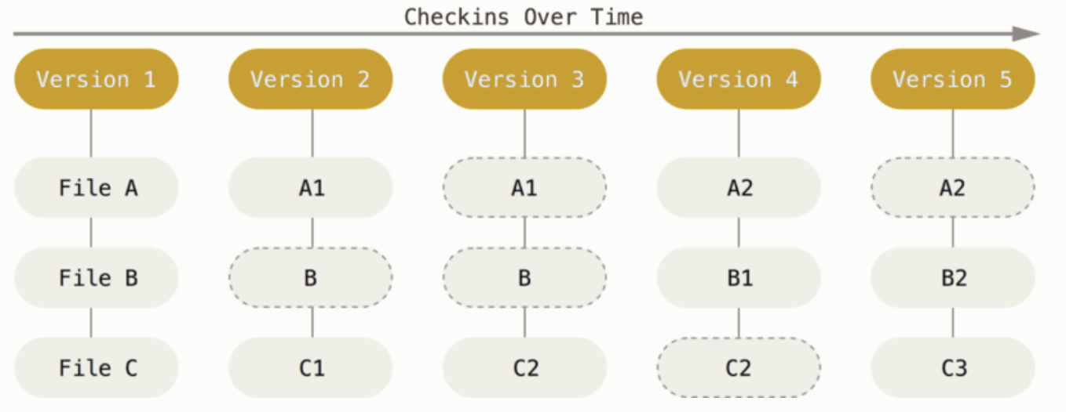
Snapshot-based version control system

Slide 11
Git is an example of a distributed version control system
Snapshots, not differences
Nearly every operation is local

Slide 12
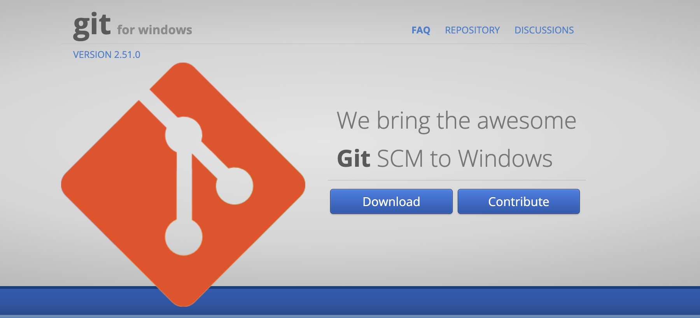
Installing Git
Installing on Debian-based distribution, such as Ubuntu
sudo apt install git-all
Installing on Windows: https://github.com/git-for-windows/git/releases/download/v2.51.0.windows.1/Git-2.51.0-64-bit.exe
https://git-scm.com/downloads/win

Slide 13
Installing Git
Installing on Debian-based distribution, such as Ubuntu
sudo apt install git-all
Installing on Windows: https://github.com/git-for-windows/git/releases/download/v2.51.0.windows.1/Git-2.51.0-64-bit.exe
https://git-scm.com/downloads/win
Notes:
To install git on mac: see https://docs.gitlab.com/topics/git/how_to_install_git/
or https://git-scm.com/downloads/mac

Slide 14
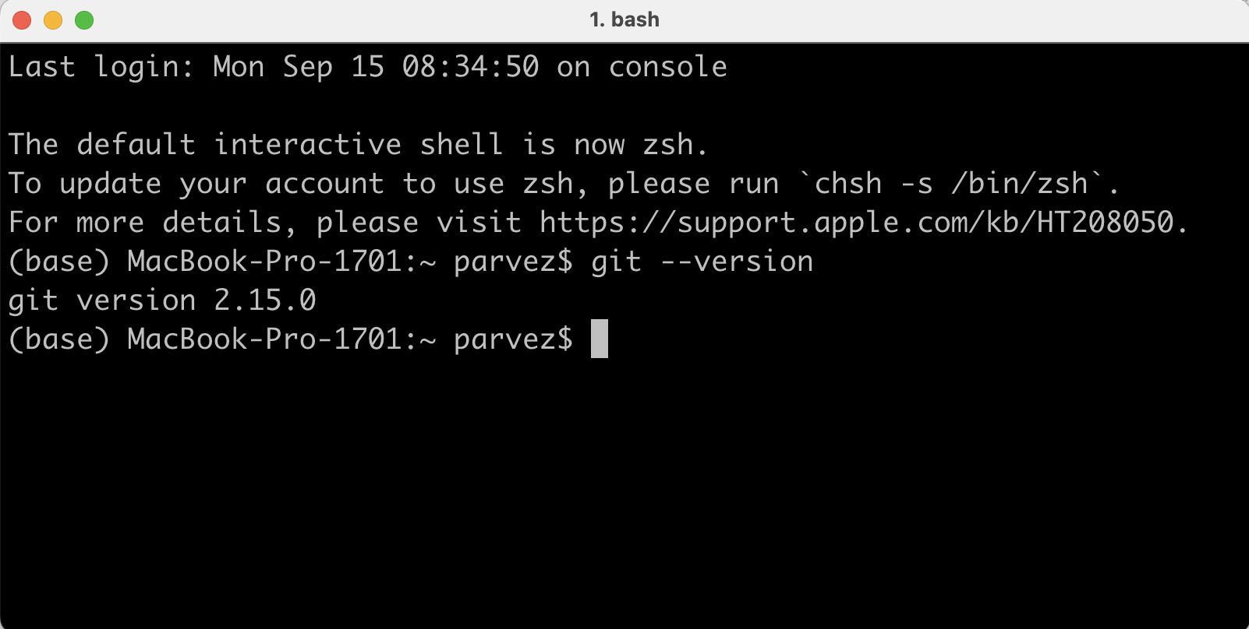
git version command
git version

Slide 15
git config command
Git comes with a tool, called git config, that allows set configuration variables that controls how git looks and behaves
git config --list | view all settings
$ git config --global user.name "John Doe"
$ git config --global user.email johndoe@example.com
Notes:
https://git-scm.com/book/en/v2/Getting-Started-First-Time-Git-Setup

Slide 16
git config command
Git comes with a tool, called git config, that allows set configuration variables that controls how git looks and behaves
$ git config --global user.name "John Doe"
$ git config --global user.email johndoe@example.com
git config <key_name>
$ git config –global user.name
John Doe

Slide 17
git config command
$ git config --list
user.name=John Doe
user.email=johndoe@example.com
color.status=auto
color.branch=auto
color.interactive=auto
color.diff=auto
...
This configuration is stored in ~/.gitconfig.

Slide 18
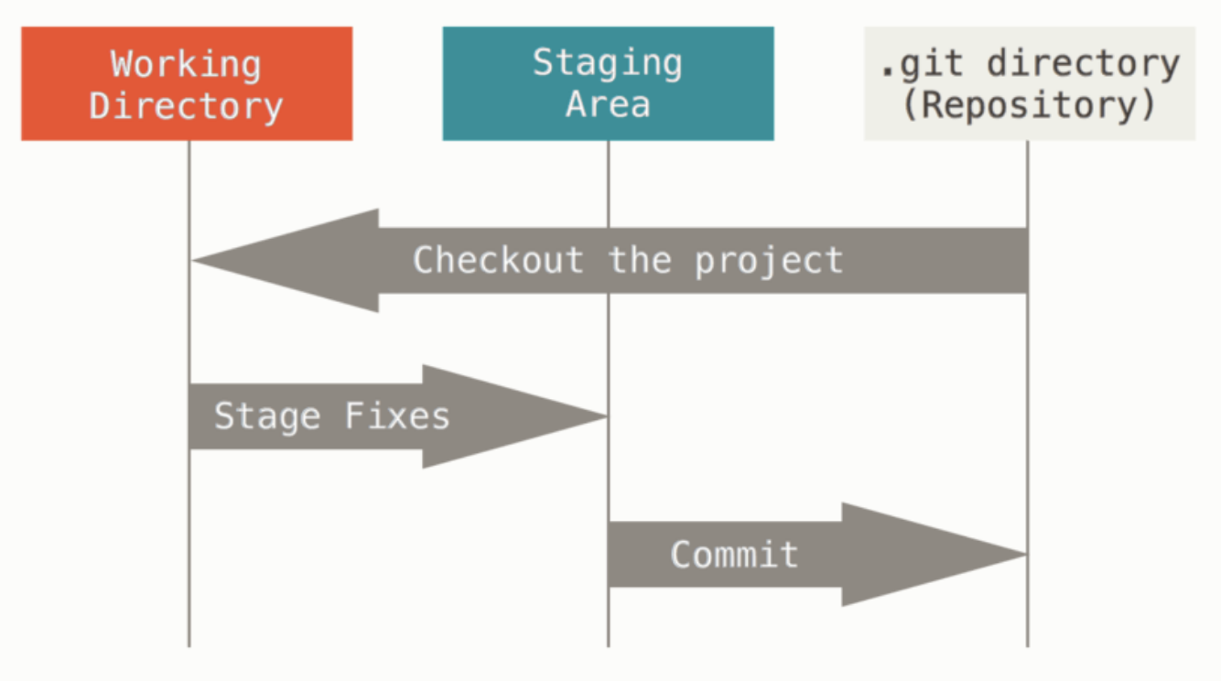
Files in Git reside in three states
Working copy: A working copy is the copy you have checked out to your working area.

Slide 19
Files in Git reside in three states
Modified: Files are changed but are not committed yet
Staged: Modified files are marked to go into next commit
snapshot
Committed: Modified files are stored in a local database

Slide 20
Files in Git reside in three states
Modified: Files are changed but are not committed yet
Staged: Modified files are marked to go into next commit
snapshot
Committed: Modified files are stored in a local database

Slide 21
Basic Workflow in Git
Create a new repository or clone a repository
Modify files in the working tree
Added the modified files to the staged area
Commit the changes

Slide 22
Getting a new repository
git init | create an empty repository in the current working directory. By default it will have one branch, named master
git clone url | Clone a repository from the url
In a directory as named in url:
$ git clone git://github.com/schacon/grit.git
In a different directory as named in url:
$ git clone git://github.com/schacon/grit.git mygrit

Slide 23
Recording changes to a git repository
git add filename | stages file that you want to track with git
git commit -m "message" | Create a commit with a message, which is a snapshot of the current repository

Slide 24
Displaying changes to a git repository
git status | Display the files changed in the index and in the working tree
git status shows the current status of your working directory, including:
Files that have been modified but not yet committed.
Files that have been added but not yet committed.
Files that are untracked (not added to version control yet).
Notes:
Why It's Important: Running git status before committing helps ensure that all changes are accounted for. This command also helps identify untracked or forgotten files.
Some common Scenarios:
If you see “untracked files,” you may need to add them using git add.
If you see “modified but not committed,” it’s a reminder to either commit or discard the changes.

